Slide 1
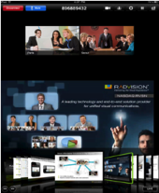
Selling Avaya Scopia XT5000
with IP Office

Slide 2
What We’ll Talk About Today
Today’s Market for Video
How You Can Make Money
Why Your Customers Need It
Why You Need To Sell It
The Solution – Scopia XT5000 / SMB9
Avaya Differentiation – SME Video Solutions
Accelerated Sales Cycle
Tools to Help You Sell
Limited-time Promotional Offer
Get Started Now

Slide 3
Today’s Market for Video Continues to Grow, but with a Significant Shift…
Desktop and mobile video is booming!
Soft clients grow 340% (2010 to 2012) *
No longer dominated by room systems
35% of users say remote collaboration is key budget driver
SME IT spend to reach
$1 Trillion by 2016
Notes:
Video related services grows 15.5% (2015)†
Room-based systems grow at 13.6% (2010 to 2016) *
Sources:
* Wainhouse 2011
† Gartner 2011
‡ Gartner 2012

Slide 4
How You Can Make Money 4 Reasons Why
Technology
Priced Right
For
New & Existing
Customers
Unique
SME Value
Low Cost
of Entry
Notes:
Main Message:
We have the architecture and solution components that provides maximum flexibility to your business, while protecting your technology investment and reducing TCO and staffing. Gets Even Stronger with RADVISION
Color Commentary:
Thanks to the 3-tier IMS-based Aura architecture, Avaya affords our users a level of freedom and consolidation other communications companies cannot.
Specifically, our single unified core platform can manage all extensions, user accounts, call admission control , and reporting for all audio, video, and conferencing connections and streams; fairly independent of end points and conferencing devices
The End points and applications can be managed by a client services team with very little knowledge of the core infrastructure, and simple leverage core authentication and server settings to rapidly install UC devices and apps across the entire organization
Conferencing can be managed as a service, fairly independent of the core and end-points & apps. It can also enjoy consolidation and TCO reduction while scaling it’s multimodal features to the entire user population (including internal and external users)
Interoperability of the core, end-points & apps, and conferencing systems can be seamlessly used by a range of other subsystems, applications, user apps and third party devices (inside or outside the enterprise)
Adding RADVISION into the mix provides:
a) more management, end points & apps, conferencing bridges and interop gateways with market leading features and price points
b) a UC-independent 323 & SIP video solution for mixed UC environments
c) free software-based and easily downloadable client software for Windows, iPads and Droid devices used as a part of a hosted and simplified conferencing service
RADVISION in the Core:
SIP & 323 Systems Mgt & Control
Deep SIP & 323 “IP” & Call Control
Highly Stable, Scalable & Reliable
UC Independent
Endpoint Agnostic Mgt
Resource Virtualization
RADVISION end points and applications
Complete Range of Devices & Apps
Rooms, Telepresence, BYOD Apps
Hosted Apps
Mobile Apps
V-V-D Sharing
323 & Sip
H264 SVC & HP
Dual 1080p/60ps
RADVISION Conferencing
Video MCU (Bridge)
Multi-Protocol Transcoding
Highly Stable
Highly Scalable
Highly Reliable
UC Independent
Patented MCU Resource Virtualization
RADVISION Interop Technologies
Range of Gateways
Leader/Innovator
A/V/D to All Devices
Firewall Transversal
323,SIP,320 Protocols
Fault Tolerance
Exclusive Msft Lync Certified
Cisco, LifeSize, Polycom, RADVISION TP

Slide 5
Why Your Customers Need It Scopia XT5000 with IP Office
Increase productivity
Enrich customer service
Improve teamwork, collaboration
Supports BYOD trends
Manage costs via reduced travel
Connect with video beyond company walls
Enables work/life balance
Strengthen relationships
Enhance company image with cutting edge technology
Notes:
Improve teamwork and collaboration
Enhance productivity for employee in all locations
Control travel costs
Enhance image with cutting-edge technology

Slide 6
Why You Need To Sell It Scopia XT5000 with IP Office
Unique SME value prop: desktop / mobile video
Nothing available at this price point from competitors
Drive incremental revenue via expanded, high-margin UC offer
Exceptional user experience
Quick & easy to sell, install and service
Re-energize your customer base with an upgrade trigger
Key Differentiators
Business quality video
Highly secure
Works with room systems
Robust mobile client capabilities
Notes:
Improve teamwork and collaboration
Enhance productivity for employee in all locations
Control travel costs
Enhance image with cutting-edge technology

Slide 7
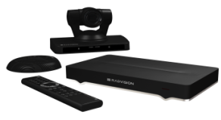
The Solution:
Scopia XT5000 with SMB9 Desktop/Mobile SW:
HD Video Conferencing Room System
Dual 1080p 60 video & content
H.264 High Profile & Scalable Video Coding
9 participant MCU (8 + the MCU)
Dual display support
PTZ camera with 10X optical zoom
BYOD HD video conferencing
Desktop sharing capability
Continual presence
No client licenses, free apps
PC, Mac, iOS, Android support
Secure firewall traversal
Optimized for internet/wireless networks
Avaya IP Office Requirements/Restrictions
Essential Edition or higher
IP Office 8.1FP1 (SP3)
Registers as Avaya SIP endpoint; no 3rd party SIP license needed
IP Office video soft client not supported

Slide 8
Avaya Differentiation for SME Video Solutions
Features
PC/Mac Desktop Client | Included | Extra | Extra | Extra
BYOD Mobile Client (iOS, Android; Smartphone, Tablet) | Included | Extra | Extra | Extra
Remote Firewall Traversal | Included | Extra | Extra | Extra
Clients Supported in Meeting | 8 or 9 | 4 | 4 | 4
Dual HD room system capability (resolution/frame rate w/video & content) | 1080p60 / 1080p60 | 1080p30 / 1080p15 | 1080p60 / 1080p30 | 1080p30 / 720p5
H.264 High Profile / H.264 SVC | Included | N/A | Included | N/A
Room System Camera Zoom | 10x | 4x | 12x | 10x
iPad Room System Control | Included | N/A | Extra | N/A
Price: Multi-participant server, desktop/mobile clients, HD room system, PTZ camera, firewall traversal | $ | $$ | $$$ | $$

Slide 9
Accelerated Sales Cycle
Pitch
Demo
Propose
Close
Discovery
ID opportunities
Verify need, budget & buying power
Show solution
User customer network, & devices
Share use cases
More demos needed?
Build proposal
Prepare quote
Deliver pitch
Overcome objections
Quote
On-site evaluation
Sign
10:00 AM
2:00 PM
3:00 PM
Initial Contact
30 Days
Close
Day 1
Week 1
Month 1
Notes:
As a business owner, you need to see a quick return on investment. You’ve found it with Avaya and IP Office. Once you decide to become an Avaya Business Partner, you could actually be authorized to sell in less than 8 hours with no dollar investment! Just obtain your SSO log in, Access Avaya Universities IP Office Selling class and pass the assessment…You are ready to sell your first IP Office system!
As you can see from the example, we boast a 25 – 35% partner margin on hardware sales… This margin differs from partner to partner depending on their sales capability. We provide the tools and training necessary for you to realize success with IP Office.
Now if you are interested in generating additional margin and revenue you can take the next steps in investment and become Implement and Maintain certified.

Slide 10
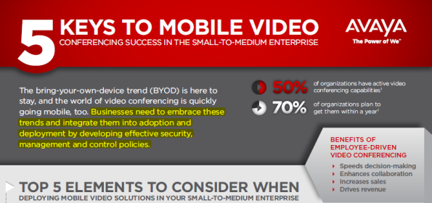
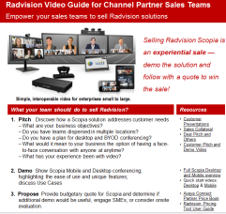
Tools to Help You Sell
Awareness
Enablement
Lead Gen
avaya.com
Infographic on Mobile Video trends in the SME space (packaged with email and online banner asset)
Demos, Scripts & Videos
Scopia DESKTOP Quick Start Video
Scopia MOBILE Quick Start Video
Customer Presentation
Fact Sheet
Competitive Summaries
Demos
Global and Regional Events
Blitz Day content
IP Office/Scopia integrated campaign (May)
Use SME Blitz Day program to drive appointment setting
Content Syndication
Notes:
Awareness – Always On , www.avaya.com, SEO, You Tube
Enablement – Radvision Resource Guide, Video “Cheat-Sheet”
Lead Gen – partner ready campaigns for you

Slide 11
Limited-time Promotional Offer Now Included in Win with IP Office!
Incremental 20% off NPL added to your standard Scopia discount!
Scopia XT5000 + SMB9
Exclusively for IP Office 8.1
Available: U.S., Canada, EMEA
Partner must be Scopia-certified
Implementation & maintenance costs apply

Slide 12
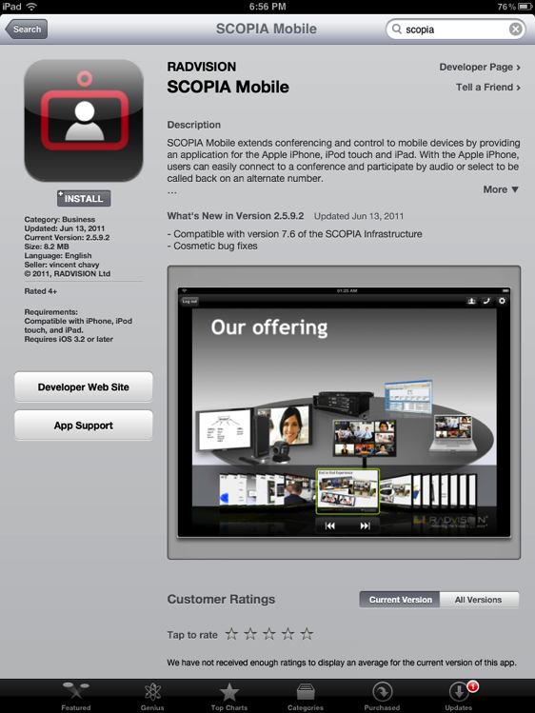
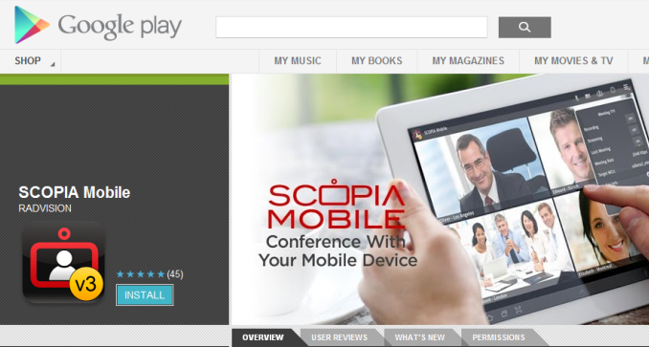
Get Started Now
Challenge your competitors
Differentiate your proposal with video
Enter new markets
Upgrade your base
Increase revenue
Extend your marketing $$$
Help your customers grow

Slide 13
Notes:
We have 2 different GUI – One for the phone and one for the tablet

